Slide 1
Probability and statistics 09-Maximum Likelihood Estimate
상명대학교 휴먼지능정보공학과

Slide 2
Estimating a parameter
Example:
Suppose we want to know the percentage p of people for whom cilantro tastes like soap.
Experiment: Ask n random people to taste cilantro.
Model: Xi ∼ Bernoulli(p) is whether the i^{th} person says it tastes like soap.
Data: x₁,..., x_{n} are the results of the experiment
Inference: Estimate p from the data.

Slide 3
Parameters of interest
Example:
You ask 100 people to taste cilantro and 55 say it tastes like soap. Use this data to estimate p the fraction of all people for whom it tastes like soap.
So, p is the parameter of interest.

Slide 4
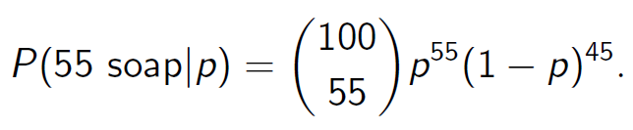
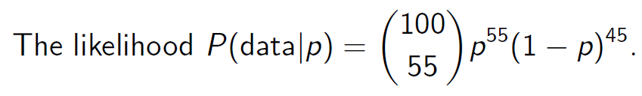
Likelihood
For a given value of p the probability of getting 55 ‘successes’ is the binomial probability
Definition:
NOTICE: The likelihood takes the data as fixed and computes the probability of the data for a given p.

Slide 5
Maximum likelihood estimate (MLE)
The maximum likelihood estimate (MLE) is a way to estimate the value of a parameter of interest.
The MLE is the value of p that maximizes the likelihood.
Different problems call for different methods of finding the maximum. Here are two others methods:
1. Calculus: To find the MLE, solve d/dp P(data|p)=0 for p. (We should also check that the critical point is a maximum.)
2. Sometimes the derivative is never 0 and the MLE is at an endpoint of the allowable range.

Slide 6
MLE with a limited range of hypothesis
A coin is taken from a box containing three coins, which give heads with probability p =1/3, 1/2, and 2/3. The mystery coin is tossed 80 times, resulting in 49 heads and 31 tails.
Question: What is the likelihood of this data for each type on coin? Which coin gives the maximum likelihood P(D|p)?

Slide 7
Answer
The likelihood P(D|p) = ₈₀C₄₉ p⁴⁹(1-p)³¹
for p=1/3 → P(D|p=1/3)=6.24*10-7
for p=1/2 → P(D|p=1/2)=0.024
for p=2/3 → P(D|p=2/3)=0.082
The maximum likelihood is when p =2/3 so this our maximum likelihood estimate is that p =2/3.

Slide 8
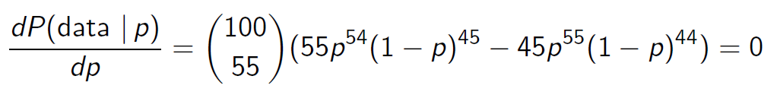
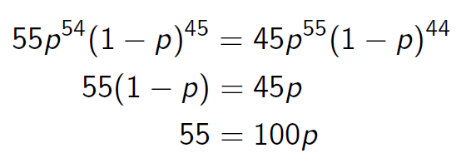

Cilantro tasting MLE
The MLE for the cilantro tasting experiment is found by calculus.
A sequence of algebraic steps gives:
Therefore the MLE is

Slide 9
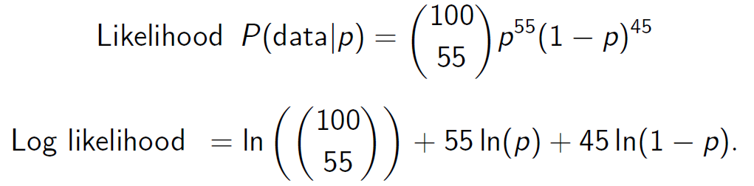
Log likelihood
Because the log function turns multiplication into addition it is often convenient to use the log of the likelihood function
Example.

Slide 10
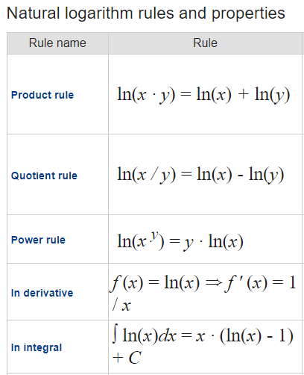
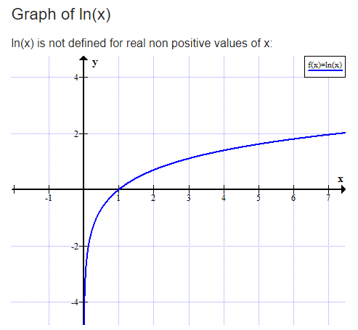
Natural logarithm

Slide 11
Example
A coin with unknown Head probability.
Tossed 80 times, 49 heads & 31 tails.
Find the likelihood and log likelihood functions.
What is the maximum likelihood estimate for p?
Solution:
Likelihood function: P(D|p) = P(49 heads with 80 tosses| Head probability = p) =₈₀C₄₉ p⁴⁹(1-p)³¹.
Log likelihood function: ln(₈₀C₄₉)+49ln(p)+31ln(1-p).
To find the MLE of p, we take the derivative and set it 0, and solve it for p.
d(ln(₈₀C₄₉)+49ln(p)+31ln(1-p))/dp = 49/p - 31/(1-p) = 0. → 49-49p = 31p → p=49/80.

